Slide 1

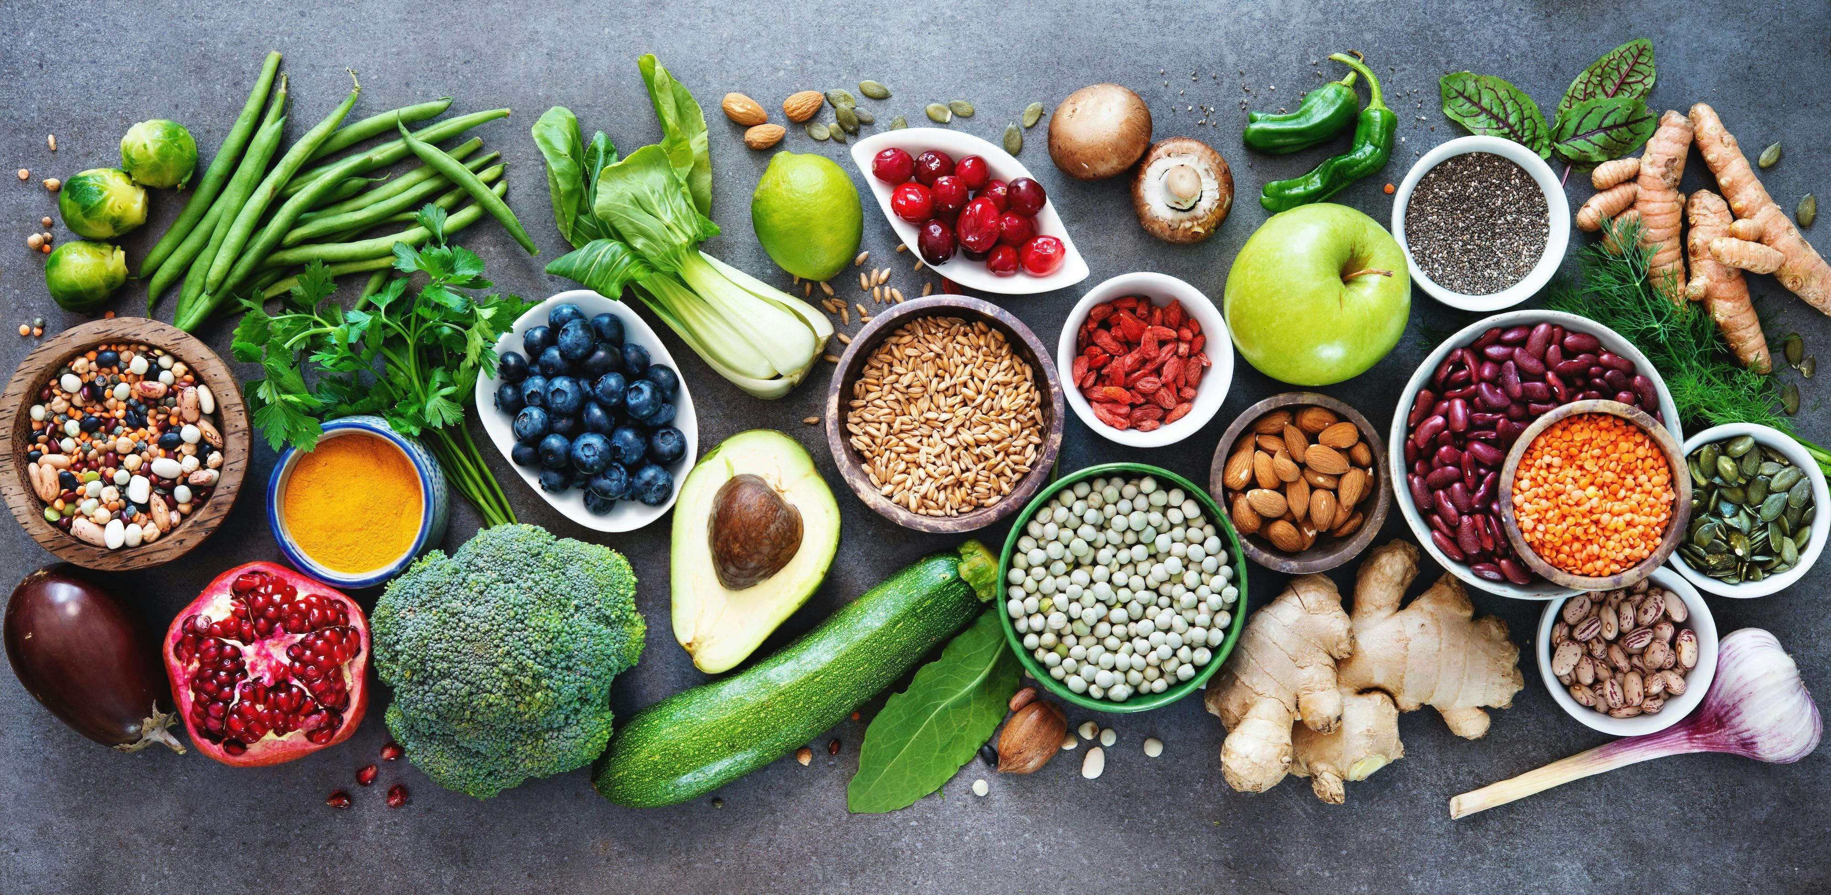
NUTRISENSE AI
Revolutionizing Personalized Diet Planning with Large Language Models
14th Dec, 2024

Slide 2
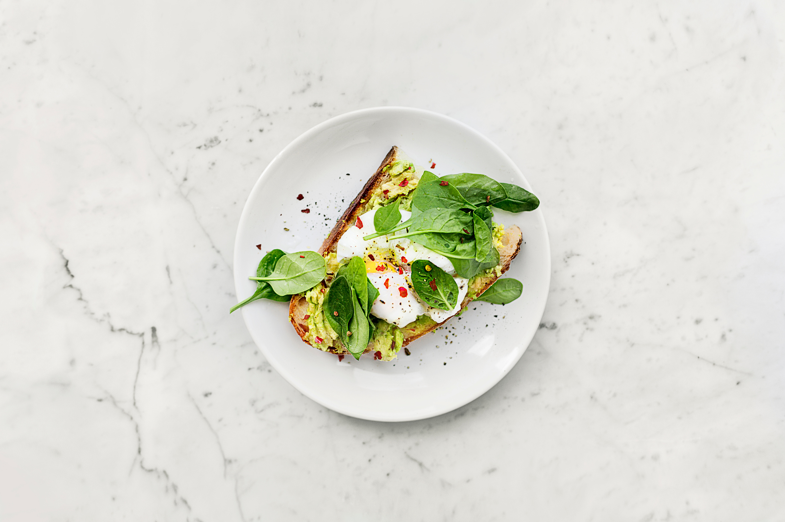
AGENDA
BUSINESS PROBLEM
ABOUT DATA
EDA
ANALYSIS
ACTIONABLE INSIGHTS
2

Slide 3





MEET OUR TEAM
Praveen Mohankumar
Achintya Mishra
Project Manager
Sr. Data Scientist
Yash Bhardwaj
Arushi Makraria
Gen AI Lead
Gen AI Manager
3

Slide 4
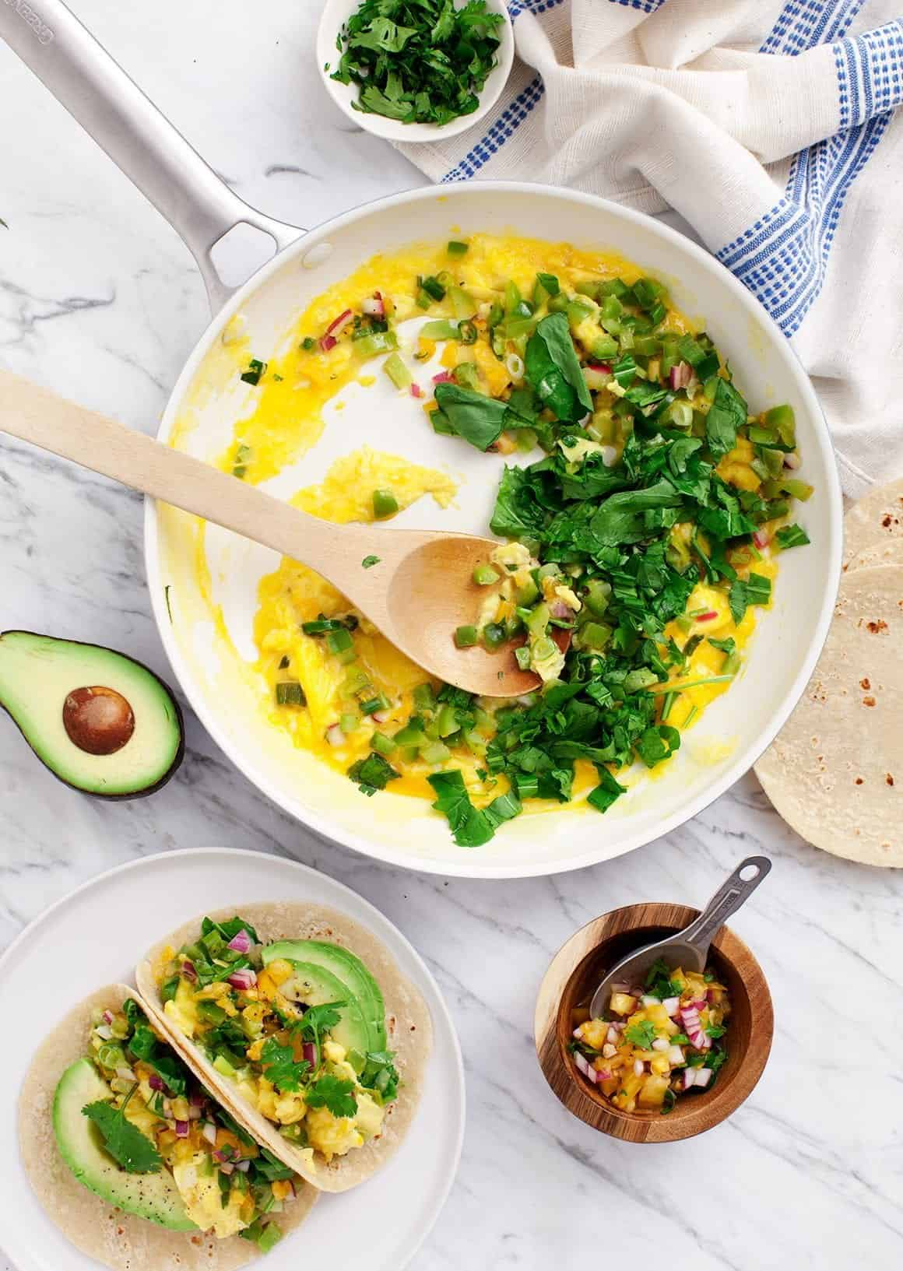
EXECUTIVE SUMMARY
What is NutriSense AI?
A smart nutrition assistant powered by LLM Agents.
Core Features:
Generates recipes based on user-provided ingredients or requirements with detailed instructions and visuals. Provides comprehensive nutritional analysis for the recipe.
Project Design:
Integrated into a chatbot using Chainlit for user interaction.
Key Insights:
Utilizes a globally representative dataset for inclusivity and accuracy.
Delivers actionable, personalized nutrition guidance.
4

Slide 5

BUSINESS
PROBLEM
PROBLEM STATEMENT
How can consumers receive personalized, actionable dietary guidance tailored to their unique health goals amidst overwhelming generic advice?
GOAL
To develop an AI-powered nutritionist using LLMs to provide, evidence-based dietary suggestions. The solution aims to improve health outcomes and accessibility by offering tailored meal plans and nutritional insights.
5
Notes:
In today's world, consumers are bombarded with generic dietary advice that often falls short of addressing their unique health goals and nutritional needs. This leads us to the central problem we aim to solve:
"How can consumers receive personalized, actionable dietary guidance tailored to their unique health goals amidst overwhelming generic advice?"
[Pause] "Our solution directly addresses this issue through innovation."
Goal: "We aim to develop an AI-powered nutritionist using large language models (LLMs). This solution will provide evidence-based dietary suggestions, offering tailored meal plans and nutritional insights to improve health outcomes and accessibility."
[Closing] "This vision combines cutting-edge AI with human-centered design to revolutionize personalized nutrition."

Slide 6
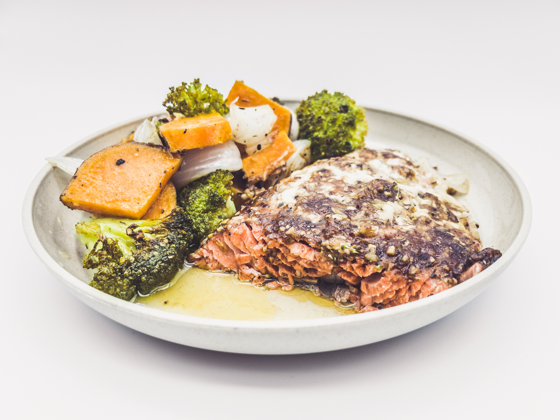


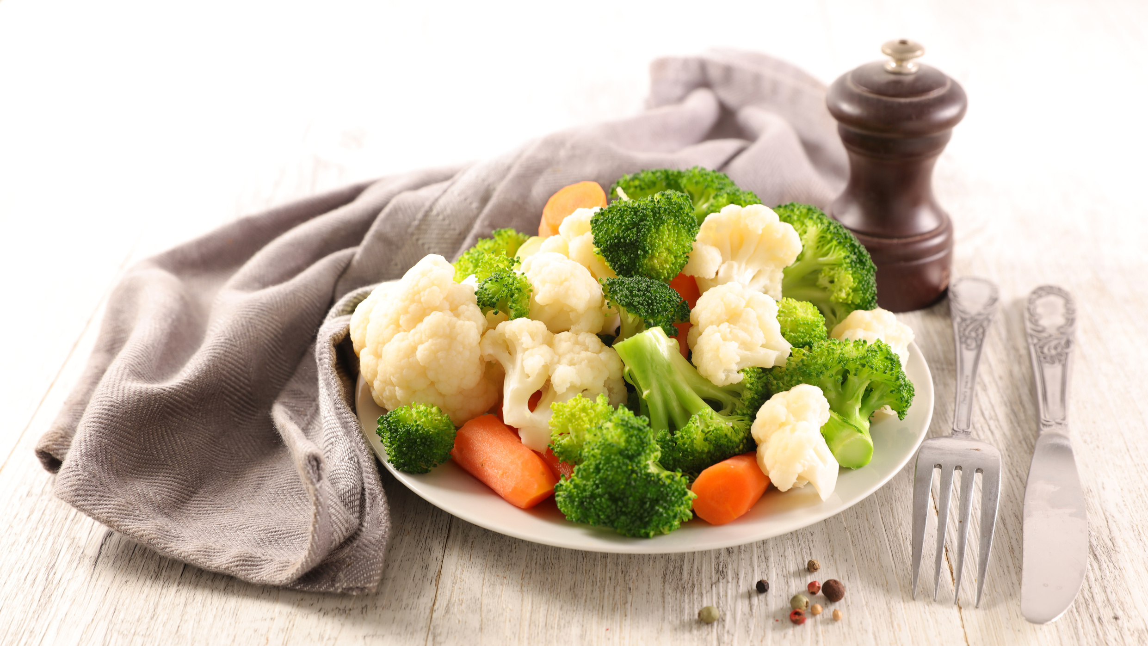

RAW DATA TO NUTRISENSE INSIGHTS
100 Healthiest Foods: Nutrition and Origin.
Imputed missing values based on reliable web sources.
Created new feature after converting quantities to grams for consistency.
Data Source
6
Notes:
"To make this vision a reality, our first step was to curate and refine a robust dataset as the backbone of the AI model."
Key Steps Taken:
100 Healthiest Foods: Nutrition and Origin "We started with a dataset of the 100 healthiest foods, ensuring detailed information on nutrition and origin was included."
Imputed Missing Values "We addressed any missing values using reliable web sources to maintain accuracy and completeness."
Feature Engineering "We also created new features, such as standardizing quantities into grams, to ensure consistency and readiness for analysis."
[Closing] "These steps set the stage for developing a reliable, scalable AI model that offers actionable insights tailored to individual needs.”
Passing it over to Arushi

Slide 7
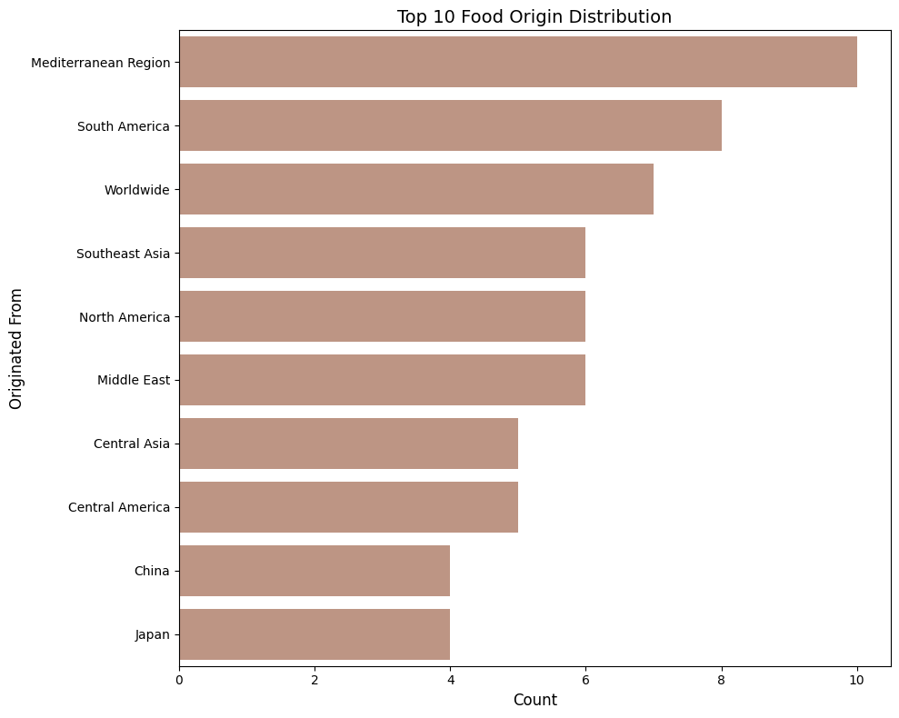
FOOD ORIGIN INSIGHTS
Top contributions from diverse regions like the Mediterranean, South America, and Southeast Asia ensure balanced, globally representative data.
7

Slide 8
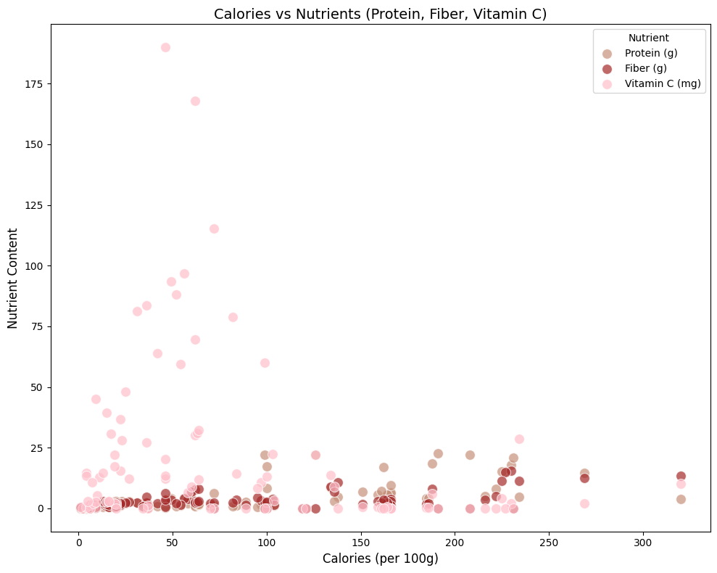
NUTRIENT VS CALORIE DENSITY
This analysis highlights the relationship between the nutritional content (protein, fiber, vitamin C) and calorie count to identify nutrient-dense foods.
8

Slide 9



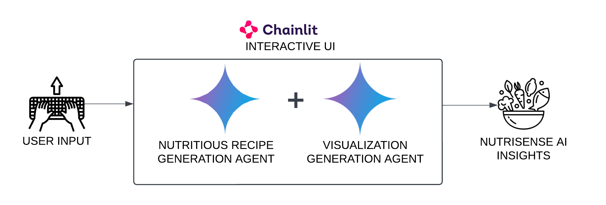


BUSINESS SOLUTION WITH NUTRISENSE AI
Objective: Empower users with personalized nutrition guidance
Tools Utilized:
Python
Tableau
Seaborn
Chainlit
Gemini Pro
Business Impact:
Enhances user engagement.
Promotes healthy eating choices with accurate insights.
9

Slide 10
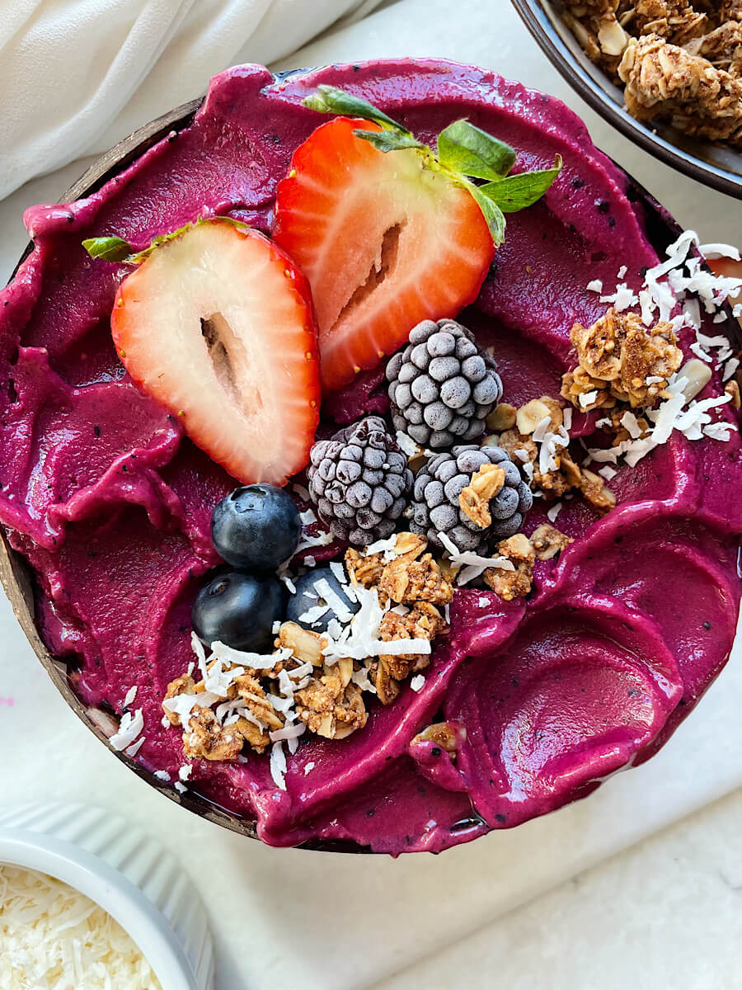
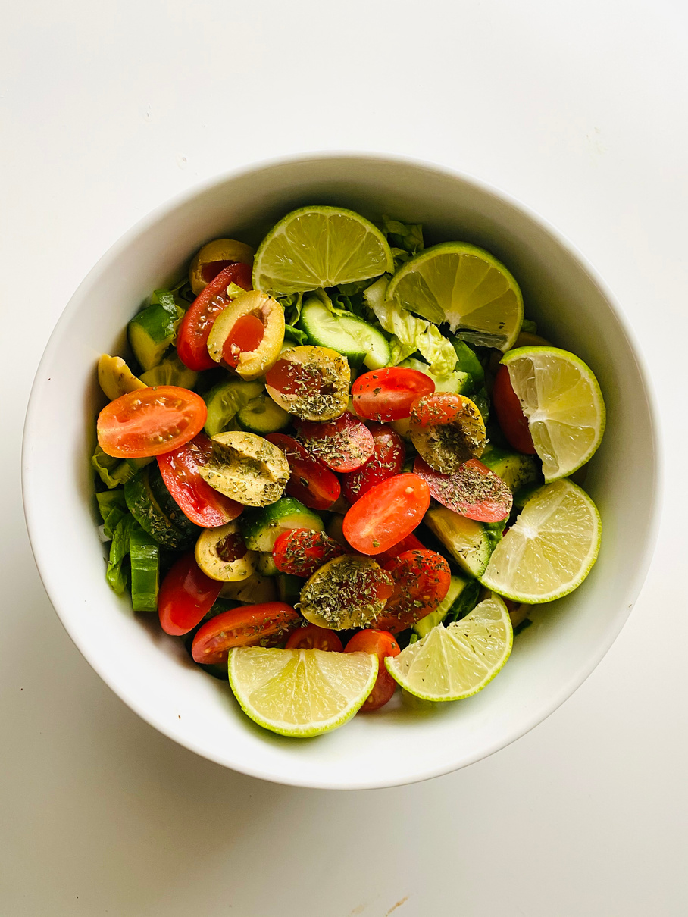
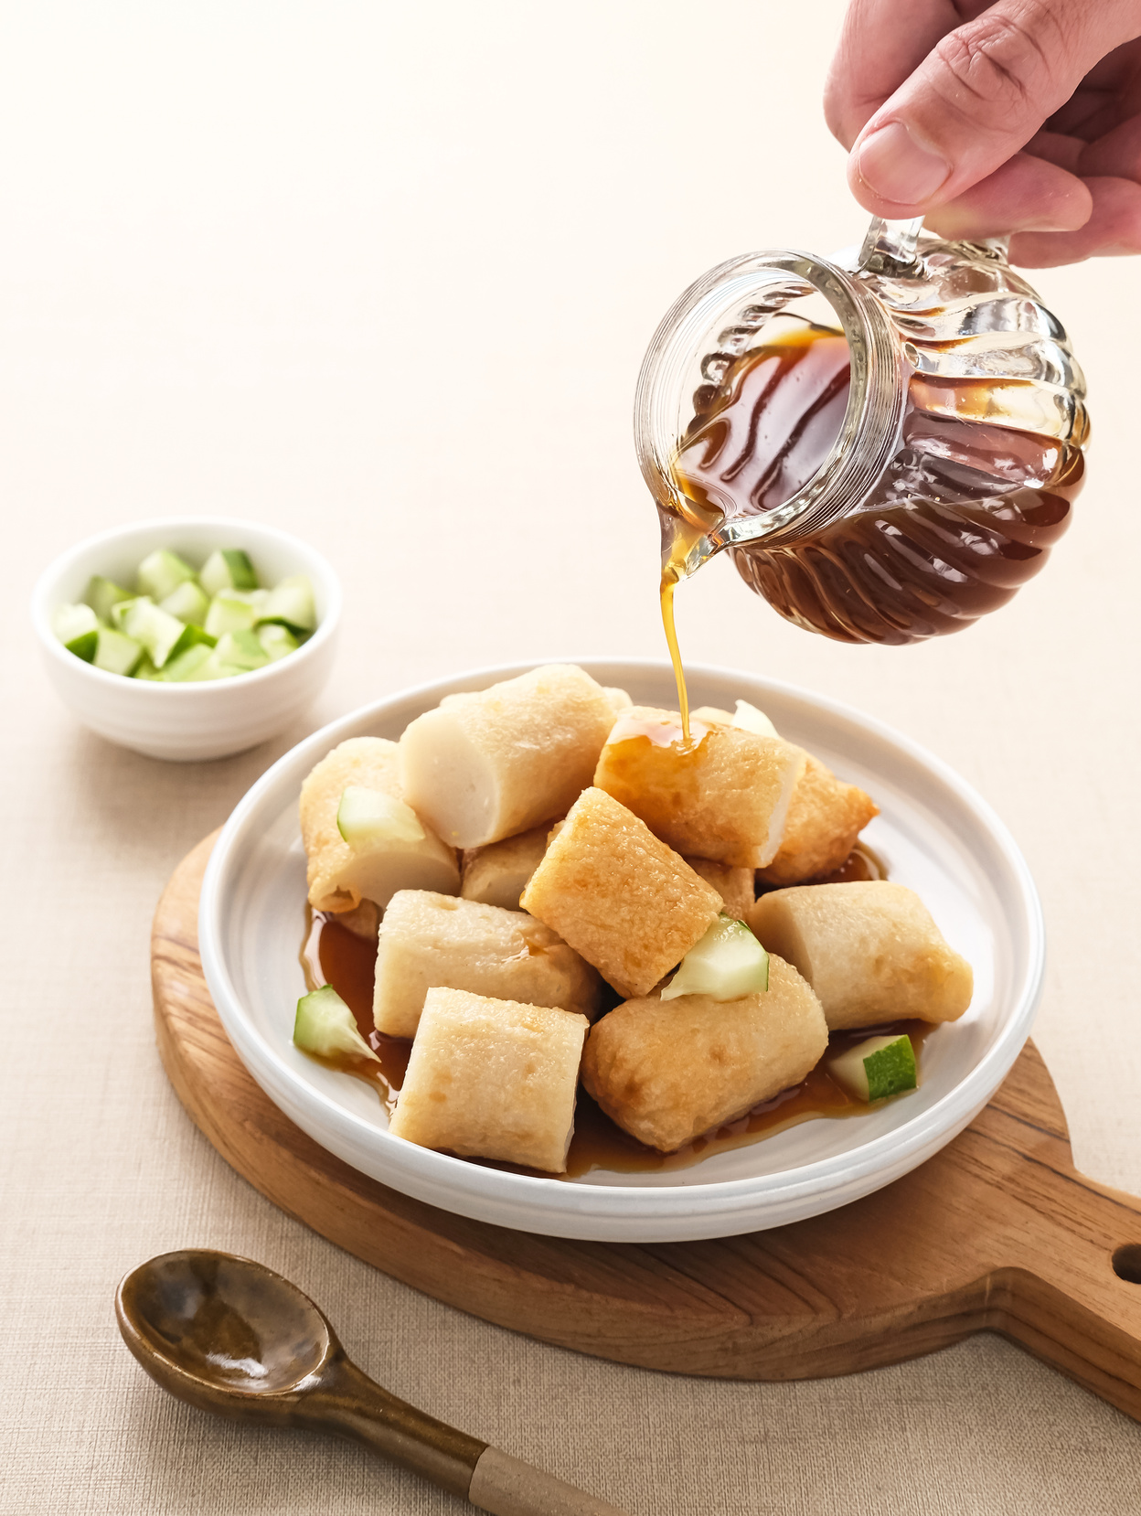
WHY NUTRISENSE AI?
NutriSense AI showcases immense potential in revolutionizing personalized nutrition by employing LLM agents for recipe generation and nutrient profiling.
Future scope includes augmenting the ingredient repository, incorporating adaptive user feedback loops, and forging collaborations with health-tech platforms to amplify reach and utility.
10
Notes:
The analysis underscores a globally representative dataset, ensuring inclusivity and versatility.

Slide 11

DEMO VIDEO
11

Slide 12
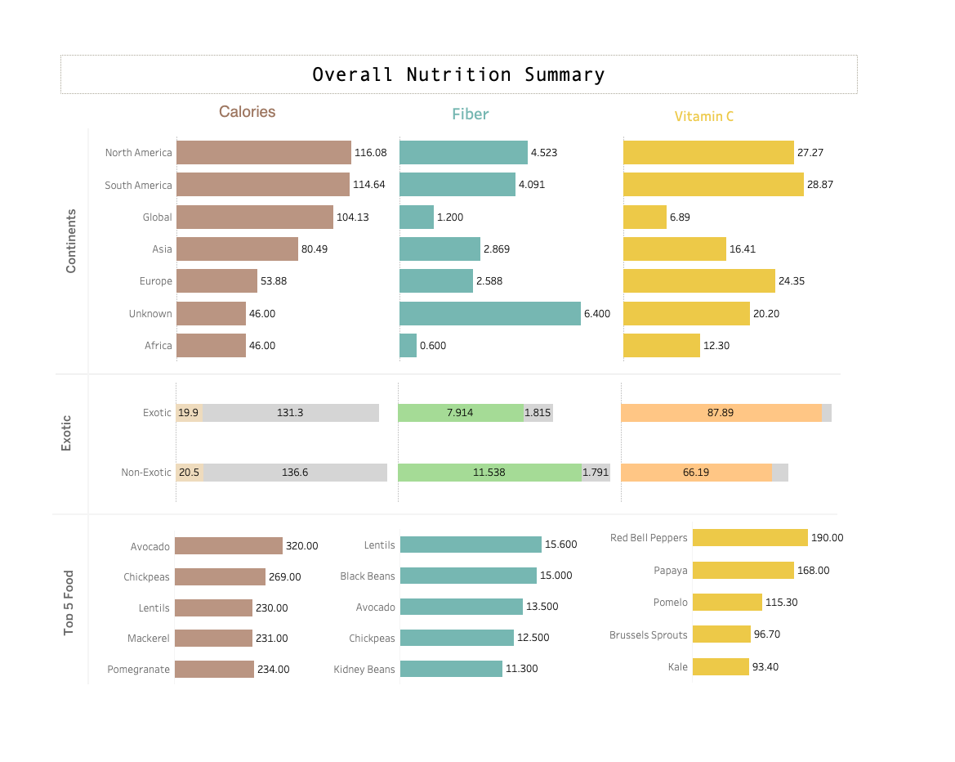
DASHBOARD
HIGHEST NUTRITION BY CONTINENT:
North America leads in calories (116.08) and fiber (4.523), while South America leads in Vitamin C (28.87).
LOWEST NUTRITION BY CONTINENT:
Africa has the lowest values across all categories: calories (46.00), fiber (0.600), and Vitamin C (12.30).
TOP FOOD BY FIBER AND VITAMIN C:
Fiber: Lentils (15.600) and Black Beans (15.000) are the top sources.
Vitamin C: Red Bell Peppers (190.00) and Papaya (168.00) are the richest.
Avocado (320 calories) and Chickpeas (269 calories) dominate the calorie category, showing their energy density.
12
Notes:
Here are five findings from the nutrition summary shown in the image:
Continent-Level Insights:
North America and South America have the highest calorie intake, with 116.08 and 114.64, respectively, while Africa has the lowest at 46.00.
Fiber intake is highest in North America (4.523), followed by South America (4.091). Africa has the lowest fiber intake at 0.600.
Vitamin C intake is highest in South America (28.87) and North America (27.27), with Africa again having the lowest (12.30).
Global and Unknown Comparisons:
The global average of calories is 104.13, but unknown regions match Africa's calorie value at 46.00.
Unknown regions have the highest fiber intake (6.400), significantly exceeding the global average of 1.200.
Exotic vs. Non-Exotic Foods:
Exotic foods provide slightly fewer calories (19.9 vs. 20.5) and slightly less fiber (7.914 vs. 11.538) compared to non-exotic foods.
However, exotic foods have a higher Vitamin C content (87.89 vs. 66.19).
Top 5 Foods for Calories:
Avocado (320 calories) leads in calorie content, followed by Chickpeas (269) and Lentils (230).
Pomegranate (234 calories) surpasses Mackerel (231) in calorie contribution among the top five.
Top 5 Foods for Fiber and Vitamin C:
Lentils (15.600) and Black Beans (15.000) are the top contributors to fiber.
For Vitamin C, Red Bell Peppers lead with 190.00, followed by Papaya (168.00) and Pomelo (115.30). Kale has the least Vitamin C among the top five foods (93.40).

Slide 13
THANK YOU
13

Slide 14

GitHub Link
13

Slide 15
REFERENCES
100 Healthiest Foods: Nutrition and Origin
Tuftsfoodismedicine.org
Im2recipe(MIT)
LangGraph.com
langchain.com
Nutritionvalue.org
Myfooddiary.org
14

